Slide 1


RAG con Listas de SharePoint

Slide 2









Sponsors
Gold
Raffle
Collaborator
Notes:
Use this as the first slide in your slide deck

Slide 3
Ruben Toribio
AI Expert @ DNV
rtoribiog
Luis Mañez
Chief Architect @ ClearPeople
luismanez

Slide 4
01
RAG Pattern

Slide 5
Bringing Private Knowledge to LLMs
Fine tuning
Learn new skills
Retrieval
augmentation
Learn new facts

Slide 6
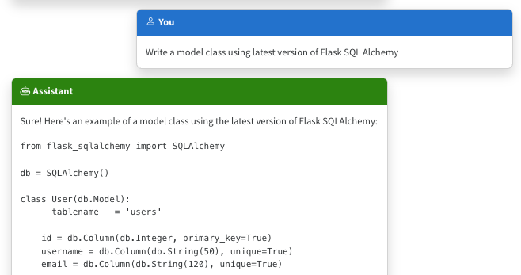
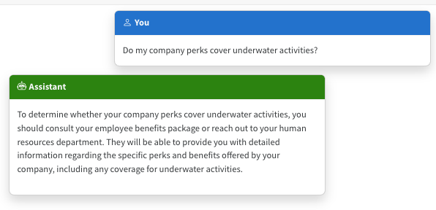
The Limitations of LLMS
Outdated public knowledge
No internal knowledge

Slide 7
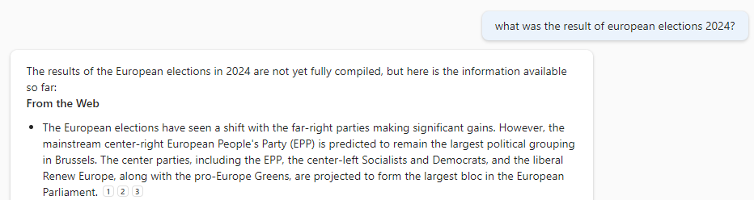
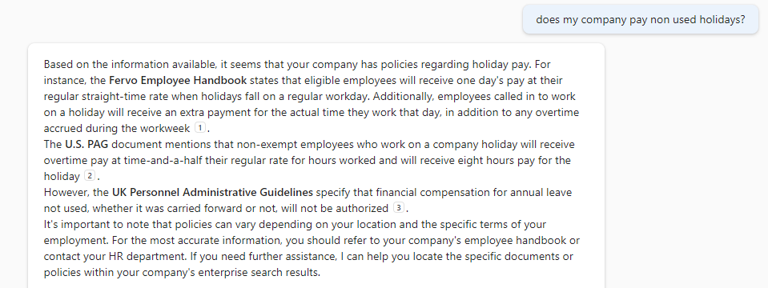
The benefit of RAG
Up-to-date public knowledge
Access to internal knowledge

Slide 8









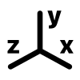













RAG Deep Dive
Documents Storage
Indexing
Text extraction
Chunking
Embeddings
Index
[-0.004828, -0.02983]
[-0.004828, -0.02983]
Chunk payload
await memory.ImportDocumentAsync("Data/expenses.xlsx");
[-0.004828, -0.02983]
Chunk Embeddings
[-0.004828, -0.02983]
Plain text
[-0.004828, -0.02983]
Metadata
………….
Retrieve
Generation
Context
[-0.004828, -0.02983]
payload + metadata 1
User query
[-0.004828, -0.02983]
[-0.004828, -0.02983]
payload + metadata 2
var answer = await memory.AskAsync(query);
[-0.004828, -0.02983]
payload + metadata 3
User query

Slide 9
Resources
https://github.com/luismanez/collabdays-madrid-2025

Slide 10
Thank you!
Questions?

